Slide 1
Social Network Analysis Class (Spring 2019) Jieun Shin
Introduction
1) Introduction
2) Overview of Social Network Analysis
3) Network Data Collection & Basic Measures
4) Personal/Ego-centric Methods
Measures & Methods
5) Fundamental Network Concepts 1 (Centrality)
6) Fundamental Network Concepts 2 (Groups)
7) Fundamental Network Concepts 3 (Positions)
8) Network Level Measures
9) Exponential Random Graph Models (ERGM)
Applications
10) Diffusion & Innovations
11) Digital Media & Network
12) Presentation
13) Presentation
14) Final Project

Slide 2
Basic Concepts : Non-directional Networks
node
A
B
D
edge
C

Slide 3
Basic Concepts : Directional Networks
A
B
D
arc
C

Slide 4
Types of Network Ties
1. Role based – brother of, father of, friend of, enemy of, lover of, teacher of, boss of
Affective – likes, loves, hates, admires
Cognitive – is familiar with, knows
Interactive – has lunch with, sleeps with, talks to, plays games with

Slide 5
Data Structure: Edge List
Source | Target | Weight
A | D | 1
A | C | 1
B | C | 1
C | D | 1
A
B
D
C

Slide 6
Data Structure: Node List
A
Source | Target1 | Target2
A | D | C
B | C
C | D
B
D
C

Slide 7
Data Structure: Adjacency Matrix
A
 | A | B | C | D
A | 0 | 0 | 1 | 1
B | 0 | 0 | 1 | 0
C | 1 | 1 | 0 | 1
D | 1 | 0 | 1 | 0
B
D
C
Notes:
The advantage of matrices is that it allows us to do mathematical manipulations directly to the network. The disadvantage is that it is an expensive data structure.

Slide 8
Data Structure (directed): Adjacency Matrix
A
 | A | B | C | D
A | 0 | 0 | 1 | 1
B | 0 | 0 | 1 | 0
C | 0 | 0 | 0 | 0
D | 0 | 0 | 1 | 0
B
D
C

Slide 9
Unimodal networks
Multimodal networks
Two-mode, bi-partite, affiliation networks
Notes:
Unimodal networks = all the entities are of the same type.
Group affiliations are fundamental in defining the social identity of individuals

Slide 10
Affiliation networks
A distinctive feature of affiliation networks is duality
The relationship between actors is co-membership
The relationship between events is overlapping or interlocking

Slide 11
Example : 5 students & 3 classes
Joe
Ben
Mac
Kim
A
B
C
Notes:
The relation “is affiliated with” from the perspective of the actor and the relation “has as a member” from the perspective of the event

Slide 12
Matrix A (4 X 3)
 | A | B | C
Joe | 1 | 0 | 1
Ben | 1 | 0 | 0
Mac | 0 | 1 | 1
Kim | 1 | 0 | 1

Slide 13
Matrix A’ (3 X 4)
 | Joe | Ben | Mac | Kim
A | 1 | 1 | 0 | 1
B | 0 | 0 | 1 | 0
C | 1 | 0 | 1 | 1

Slide 14
Transposing a Matrix
Matrix A
Matrix A’ (transpose)
 | Event A | Event B | Event C
Person 1 | 1 | 0 | 1
Person 2 | 1 | 1 | 0
Person 3 | 0 | 1 | 0
Person N | 0 | 0 | 1
 | Person 1 | Person 2 | Person 3 |  |  | Person N
Event A | 1 | 1 | 0 |  |  | 0
Event B | 0 | 1 | 1 |  |  | 0
Event C | 1 | 0 | 0 |  |  | 1
AxA’= Person by Person
A’xA= Event by Event
Notes:
Multiply the ROWS of A by the COLUMNS of B. First take the first row of A and the first column of B, and then multiply the first entries, then the second entries, and then the third entries, and then add the three products.

Slide 15
Projected Actor-by-Actor Matrix
 | Joe | Ben | Mac | Kim
Joe | 2 | 1 | 1 | 2
Ben | 1 | 1 | 0 | 1
Mac | 1 | 0 | 2 | 0
Kim | 2 | 1 | 0 | 2

Slide 16
Projected Event-by-Event Matrix
 | A | B | C
A | 3 | 0 | 1
B | 0 | 1 | 1
C | 2 | 1 | 3

Slide 17
Visualization of Graph
Graph Theory
Nodes connected by ties
Individuals connected by relations
Organizations connected by shared attributes (or exchange)
Types of lines
non-directed vs. directed
binary vs. valued
uni-plex vs. multiplex (# of relations)

Slide 18
Data Collection Methods
There are a variety of ways to collect network data.
The variety of methods can create confusion over what constitutes “network analysis”

Slide 19
Network Analysis Data Types
 | A. General | B. Specific
1. Egocentric | Roles pre-determined | Name generator
2. Sequenced | Random selection of alters | Snowball
3. Census | Nominations w/n bounded community | Roster
4. 2-mode | Nominations of events/orgs. | Membership lists

Slide 20
1. Egocentric : General - Roles
How often do you turn to _____ for social support:
Mom
Dad
Sister
Brother
Friend
Etc.
Notes:
Egocentric network can be considered as the one-step-neighborhood of an actor.

Slide 21
1. Egocentric : Specific – Name Generator Please provide the names of up to 5 people you talk to about important matters.
 | Name 1 | Name 2 | Name 3 | Name 4 | Name 5
a. How do you know _____________? | 1. Family member a. Mother b. Father c. Sister 2. Friend 3. Neighbor 4. School mate 5. Other ________ _______________ | 1. Family member a. Mother b. Father c. Sister 2. Friend 3. Neighbor 4. School mate 5. Other ________ _______________ | 1. Family member a. Mother b. Father c. Sister 2. Friend 3. Neighbor 4. School mate 5. Other ________ _______________ | 1. Family member a. Mother b. Father c. Sister 2. Friend 3. Neighbor 4. School mate 5. Other ________ _______________ | 1. Family member a. Mother b. Father c. Sister 2. Friend 3. Neighbor 4. School mate 5. Other ________ _______________
b. Does he/she live within ½ mile of your home? | No Yes | No Yes | No Yes | No Yes | No Yes
c. Is _______ male or female)? | Male Female | Male Female | Male Female | Male Female | Male Female
d. How long have you known him/her | ____ yrs. ___ mos. | ____ yrs. ___ mos. | ____ yrs. ___ mos. | ____ yrs. ___ mos. | ____ yrs. ___ mos.
e. How often do you speak with him/her? | 1. once/year 2. 1x/month 3. 1x/week 4. Everyday | 1. once/year 2. 1x/month 3. 1x/week 4. Everyday | 1. once/year 2. 1x/month 3. 1x/week 4. Everyday | 1. once/year 2. 1x/month 3. 1x/week 4. Everyday | 1. once/year 2. 1x/month 3. 1x/week 4. Everyday
f. What do you usually discuss with this person? | 1. Family life 2. Politics 3. The neighborhood 4. Work 5. Other ________ _______________ | 1. Family 2. Politics 3. Neighborhood 4. Work 5. Other ________ _______________ | 1. Family 2. Politics 3. Neighborhood 4. Work 5. Other ________ _______________ | 1. Family 2. Politics 3. Neighborhood 4. Work 5. Other ________ _______________ | 1. Family 2. Politics 3. Neighborhood 4. Work 5. Other ________ _______________

Slide 22
1. Ego-centric Network Data are Node-based
Same or Higher
Econ. Status
Primary Schooling
Older
Live Outside
of Village
Confidants
& Friends
Kin (sister-
in-law, brother)

Slide 23
1. Egocentric: Dyadic
One way to analyze ego-centric data is to convert the data to dyadic
In dyadic data, each relationship reported by the respondent is a case in the new dataset.
Dyadic data:
Increases sample size
Facilitates some types of analyses
Reflect theoretical processes of study (e.g., is behavior associated with homophily)

Slide 24
2. Sequenced and Snowball Sampling
Sequenced: random alters interviewed
Snowball: all alters interviewed
index

Slide 25
2. Sequenced : Respondent Driven Sampling
Indexes are paid for their interview and given coupons to distribute to their contacts
Index gets compensated for every alter who gets interviewed and redeems his/her coupon
Alter is now an index and gets coupons to distribute

Slide 26
3.Census : Nominations within a community
Who are your five BEST FRIENDS in this class?
Think about the five people in this class who are your closest friends. Write up to 5 names on the lines below, starting with your best friend leader on the first line. If you can’t think of five names in this class, then leave the extra lines blank.
FIRST NAME
LAST NAME
1
2
3
4
5

Slide 27
3.Census : Nominations with a roster
 | How Often Do You Talk to
 | Never | 1/Year | 1/Month | 1/Week | Daily
Bob Banks | 1 | 2 | 3 | 4 | 5
Charles Chuckles | 1 | 2 | 3 | 4 | 5
David Derivative | 1 | 2 | 3 | 4 | 5
Edward Eats | 1 | 2 | 3 | 4 | 5

Slide 28
3. Census
The most typical kind of network methodology
Usually what people think of when we say network analysis.
These data can be graphed and analyzed using matrix methods

Slide 29
2019 Network Class
n=13 format = nodelist
row labels:
1 2 3 4 5 6 7 8 9 10 11 12 13 14
Data:
1 11
2 9 10 13 3 11
3 5 12 8
4 8 11
5 8
6 8 2 3 9
….
….
….

Slide 30
Graph of 2019 class

Slide 31
Nominations vs. Roster
Nominations
Less demanding for Respondents
Unaided measure
Rank order of nominations has meaning, 1st might be closest, 2nd next closest, etc.
If network is too dense, can restrict to fewer alters (e.g., only take 1st 3 nominations)

Slide 32
Roster
Roster
Requires respondent to read all names
May be biased by the way the list is formed, alphabetical for example
If someone is left off list creates problems
Cannot rank order choices, though you can put in a rating scale

Slide 33
4. Two-Mode Data
People who attend the same events or belong to the same groups are linked through their joint participation
Matrix manipulation of the affiliation matrix provides two matrices indicating dual nature of persons and groups.

Slide 34
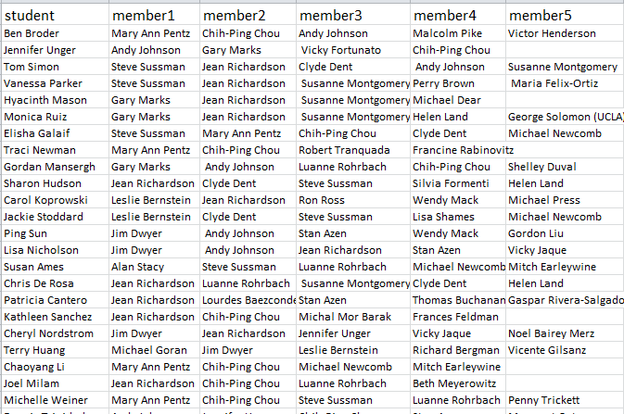
Student Dissertation Committees

Slide 35
Faculty Served on Same Committee

Slide 36
Faculty Co-membership

Slide 37
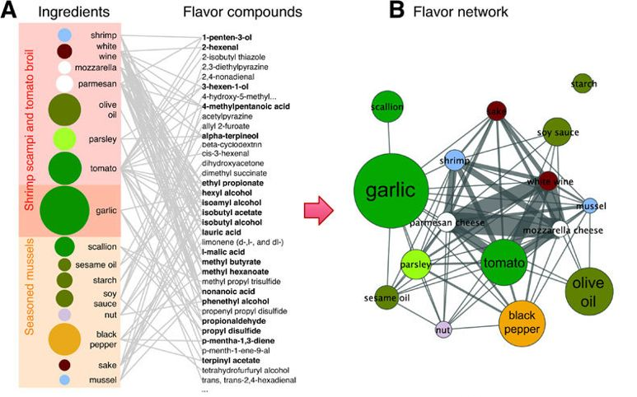
Flavor Network
Ahn et al., (2011). Flavor network and the principles of food pairing. Scientific reports.

